Slide 1

Losing Bank Customers
Presented by : Suchi Sharma
Last Updated : May 11th, 2024

Slide 2
Introduction
About Case Study:
The case study focuses on a Multinational Bank, which aims to enhance its customer retention strategies. With access to customer data, including demographics, financial behaviors, and satisfaction metrics, the bank seeks to uncover patterns and insights to improve customer retention and sustain its business.
Business Problem:
A Multinational Bank faces the challenge of retaining customers in a competitive banking landscape. Customer churn, dissatisfaction, and unresolved complaints pose risks to the bank's profitability and reputation. Understanding the factors contributing to churn and dissatisfaction is crucial for implementing effective retention strategies.
Objective:
* Identify factors influencing customer churn rates.
* Assess the impact of demographic variables (such as geography, gender, age) and banking behaviors (eg. credit score, balance,
number of products) on churn rates.
* Evaluate customer satisfaction scores, complaint resolutions, and loyalty program participation to pinpoint areas for service
improvement.
* Develop data-driven insights & recommendations to enhance customer retention strategies & sustain the bank's business
growth.

Slide 3
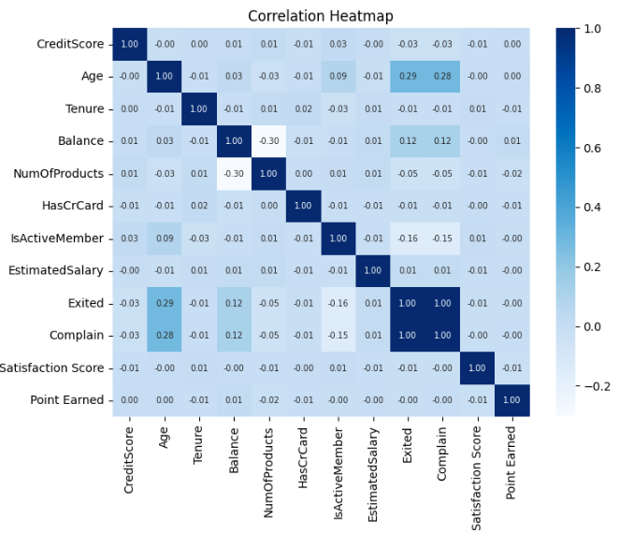
Charts & Visualizations
Correlation Heatmap :
In this heatmap, we observe strong correlations between certain variables.
Notably, the 'Exited' and 'Complain' variables are almost identical, indicating complete correlation. Additionally, there is a moderate correlation between 'Exited' customers and the 'Age' variable. 'Balance' also exhibits a mild correlation with 'Exited' customers, while 'IsActiveMember' shows a negative correlation with 'Exited' customers.

Slide 4
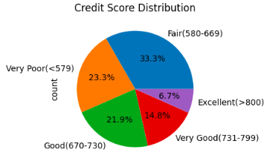
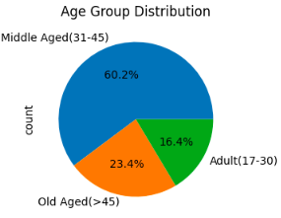
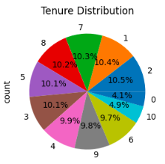
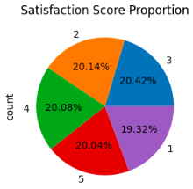
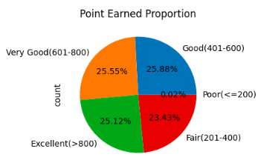
Proportion Distribution : Percentage distribution of key categorical variables, offering insights into the composition of customer demographics or characteristics.

Slide 5
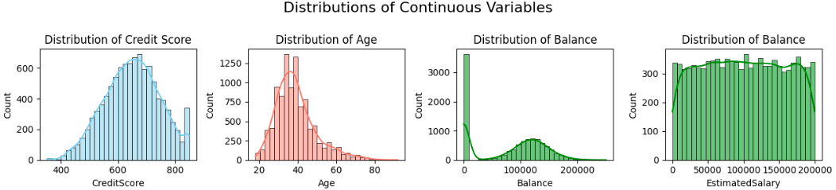
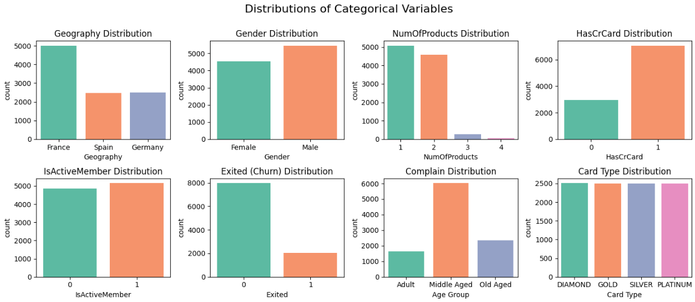
Continuous Variables Distribution: Distribution of numerical data points, showcasing central tendencies and spread for analysis of customer behaviours or trends.
Categorical Variables Distribution: Distribution of customer demographics or characteristics across key categories.

Slide 6

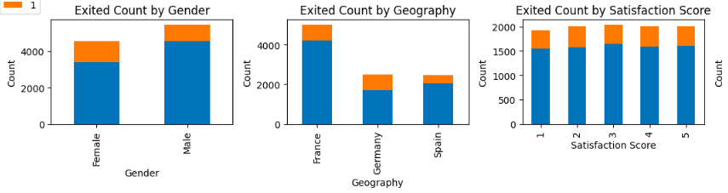
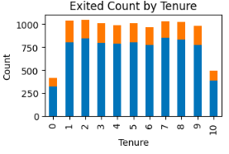
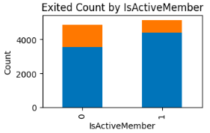
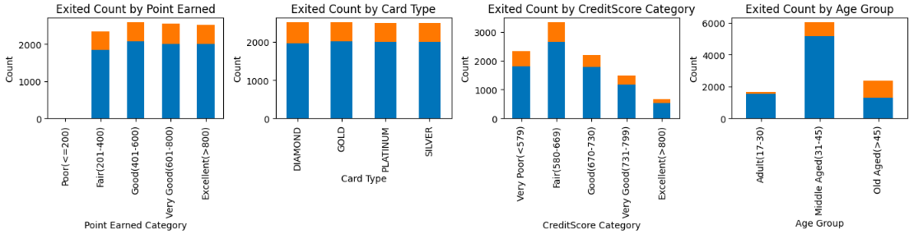
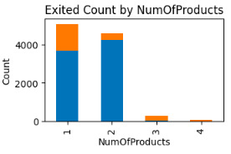
Stacked Bar Chart : Comparing exited customer’s count across categorical variables.

Slide 7
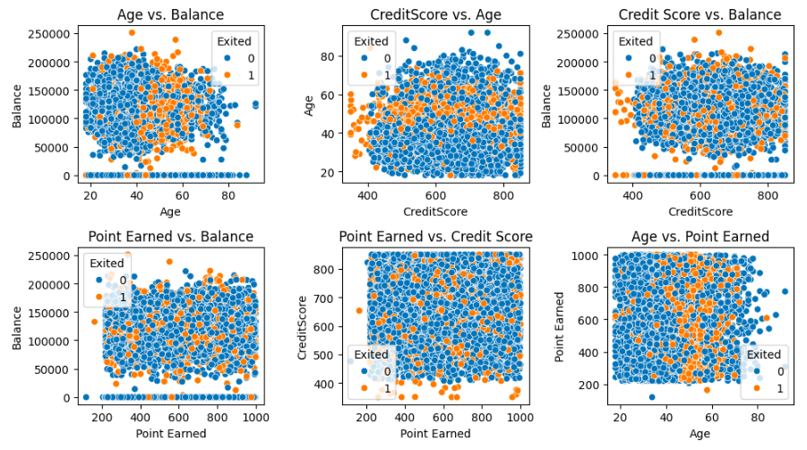
Scatter Plot : Showing key comparison between continuous variables for exited customers.

Slide 8
Insights :
Recommendation:
Credit Score - Creating targeted marketing campaigns or financial education programs to help customers improve and maintain their credit scores.
Geography - The bank should offer personalised incentives, improved customer support services, or targeted marketing campaigns designed to address the unique challenges faced by customers in Germany. This may involve collecting additional data through surveys, interviews, or customer feedback to identify underlying reasons for dissatisfaction or attrition.
Gender - The bank should propose the development of gender-specific products, services, or marketing campaigns like special promotions, loyalty programs, or financial products designed to attract and retain female clientele.
Age - The bank should provide specific examples or suggestions for trust-building programs for older and middle-aged customers. These programs could include financial literacy workshops, personalised advisory services, or dedicated customer support channels. Empowering older customers to navigate online banking platforms with confidence can help alleviate trust issues and improve overall satisfaction.

Slide 9
Bank Balance - The bank should propose the development and implementation of value-added services like personalised wealth management solutions, priority customer support, or exclusive rewards and benefits designed to incentivise loyalty and retention for customers with higher account balances. The bank can recommend offering competitive interest rates and investment opportunities to customers with higher balances. Assign dedicated relationship managers or advisors to provide personalised support and assistance, fostering trust and loyalty over time.
Number of Products - Bank can implement robust feedback mechanisms to capture customer feedback and insights regarding their experiences with the bank's products and services. Accordingly, the bank can propose the diversification of product offerings like new financial products, enhancing existing services, or creating value-added packages to provide customers with a wider range of options and tailored solutions to meet their diverse needs.
Is Active Member - The bank can propose targeted engagement initiatives aimed at reactivating inactive customers and encouraging their continued participation with the bank. This could include personalised communications, special offers, or incentives designed to reignite interest and incentivise activity. By offering perks such as discounts, bonuses, or priority.

Slide 10


